Slide 1



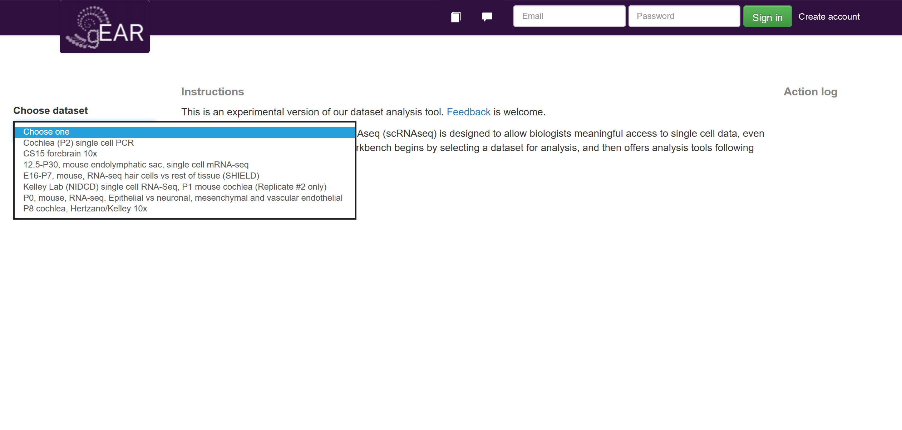
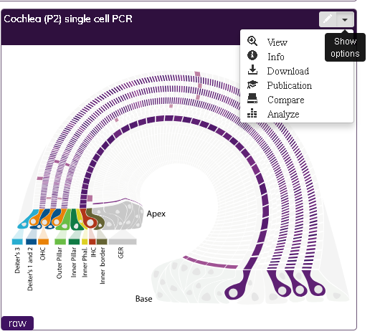
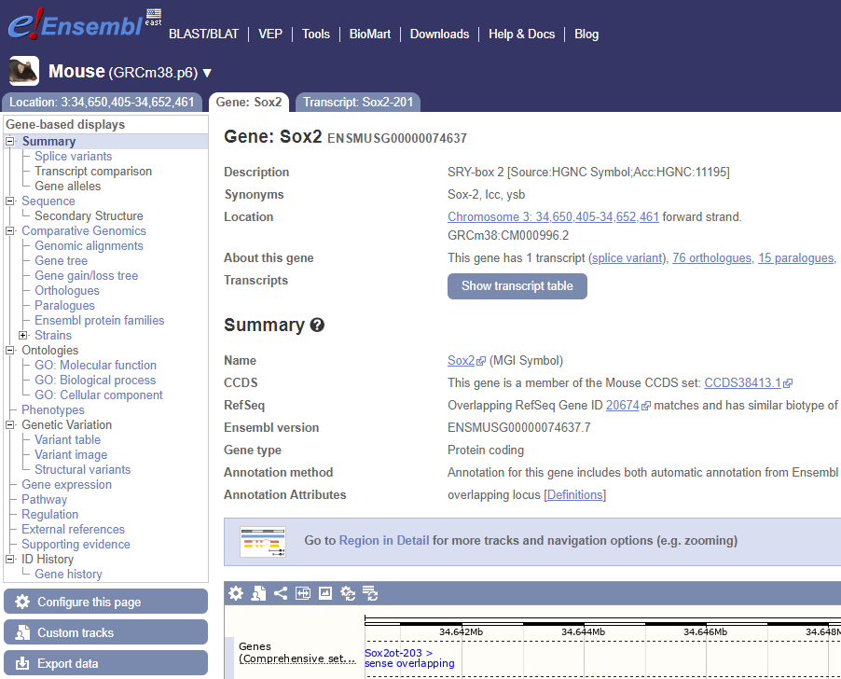
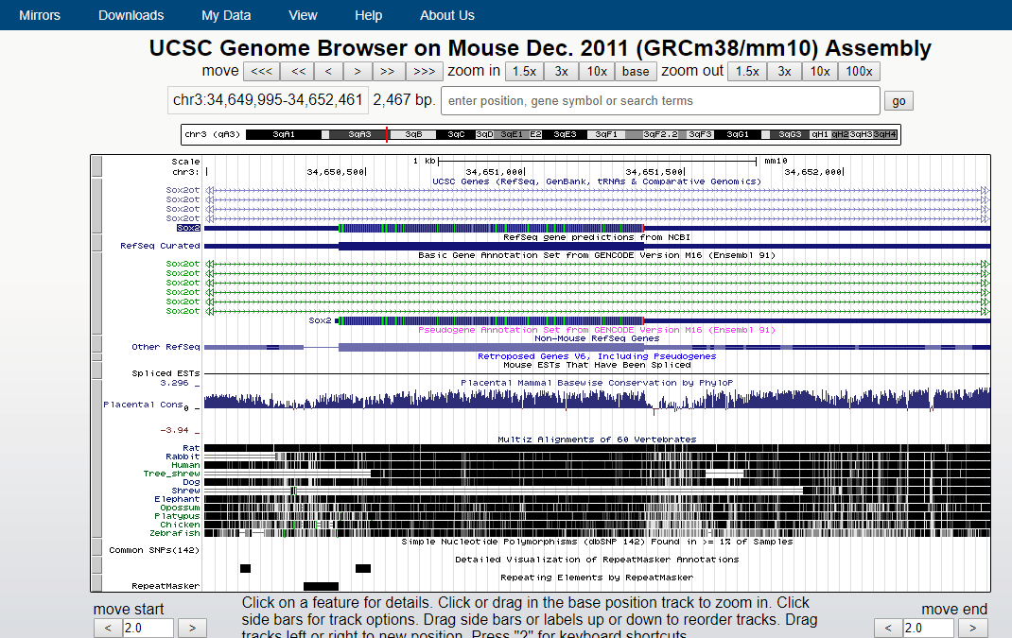
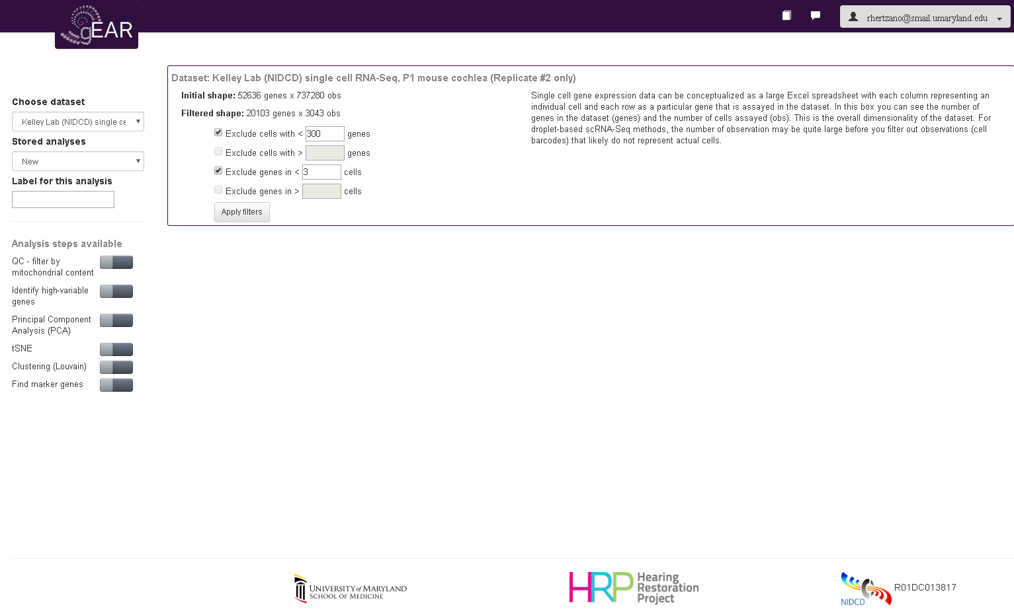
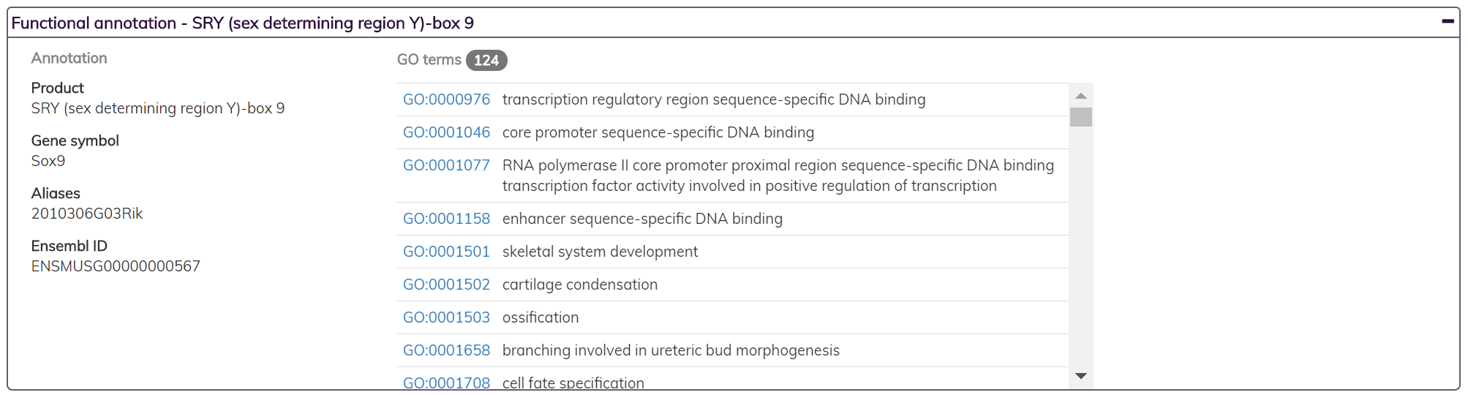
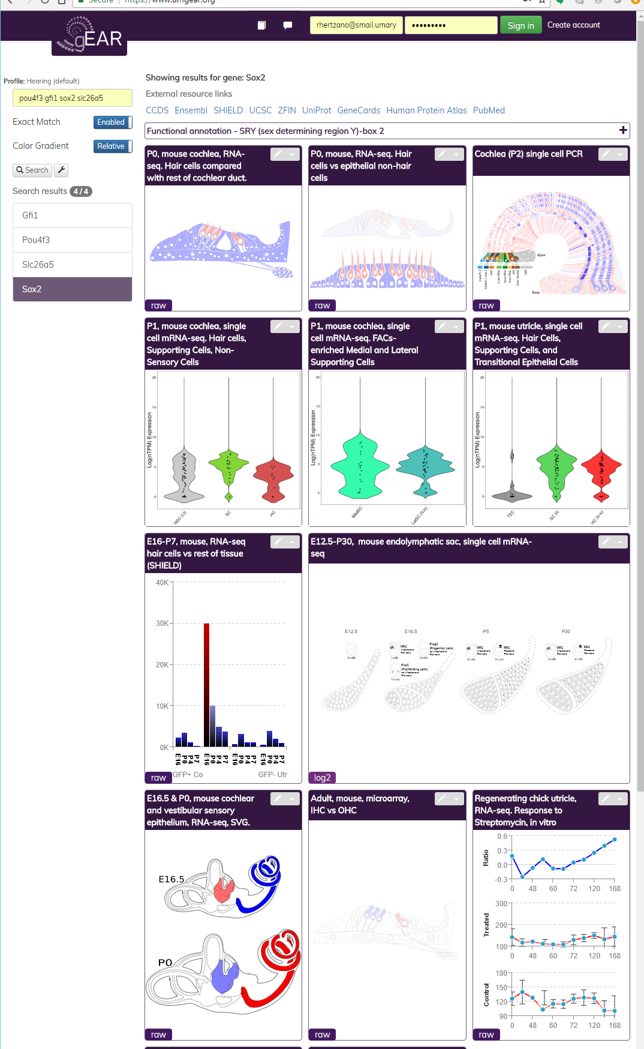
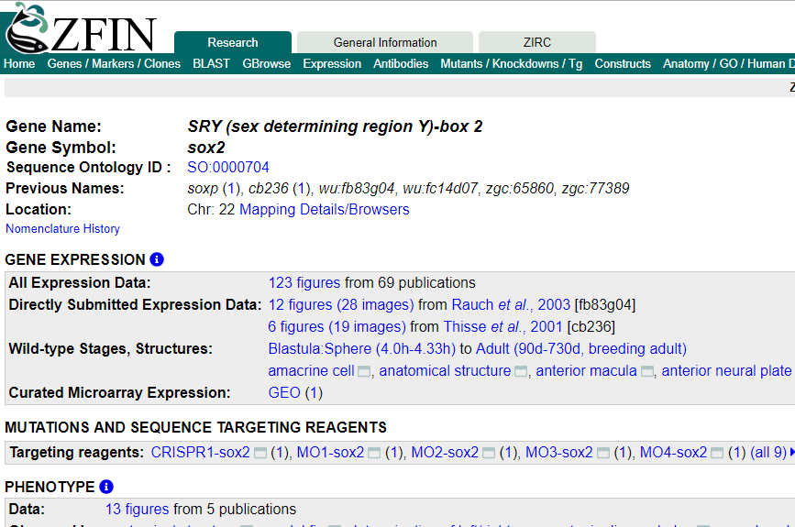
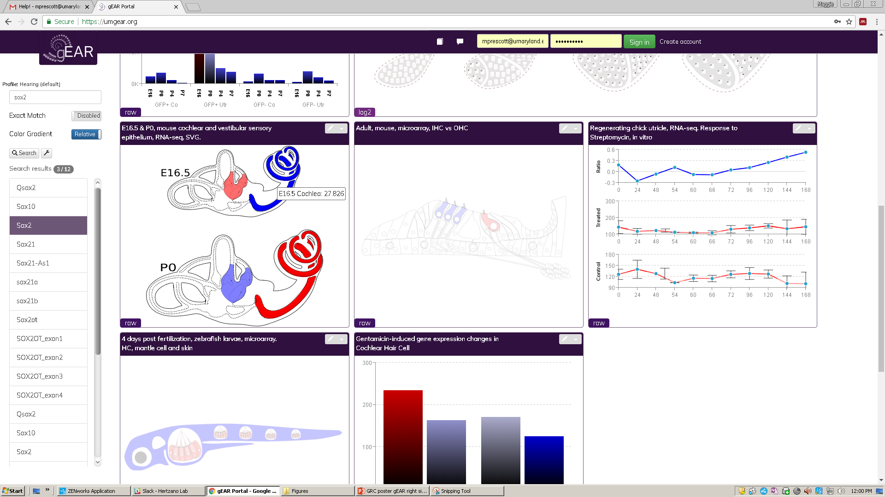
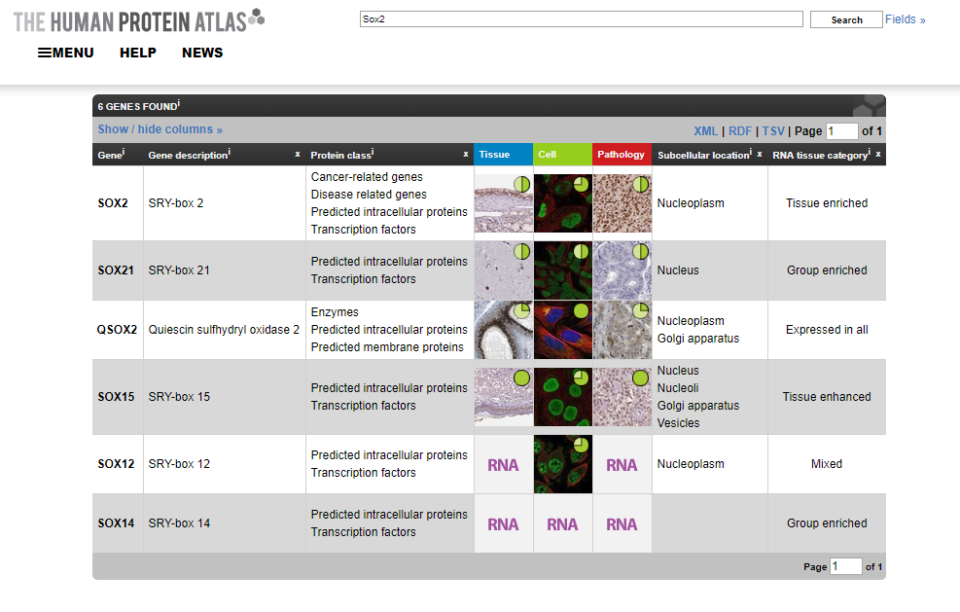
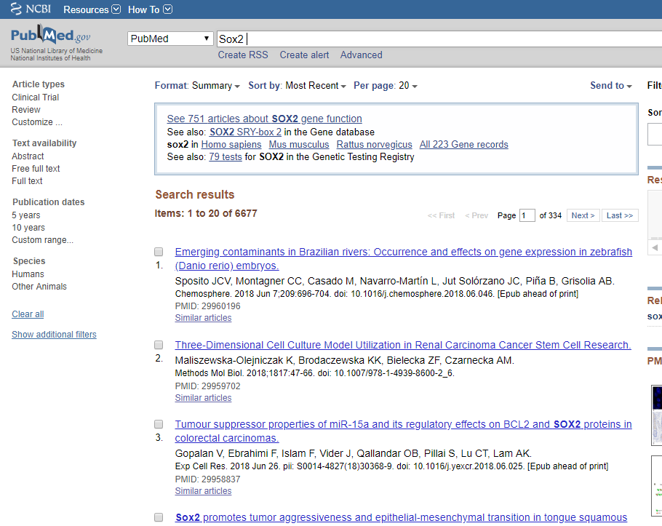

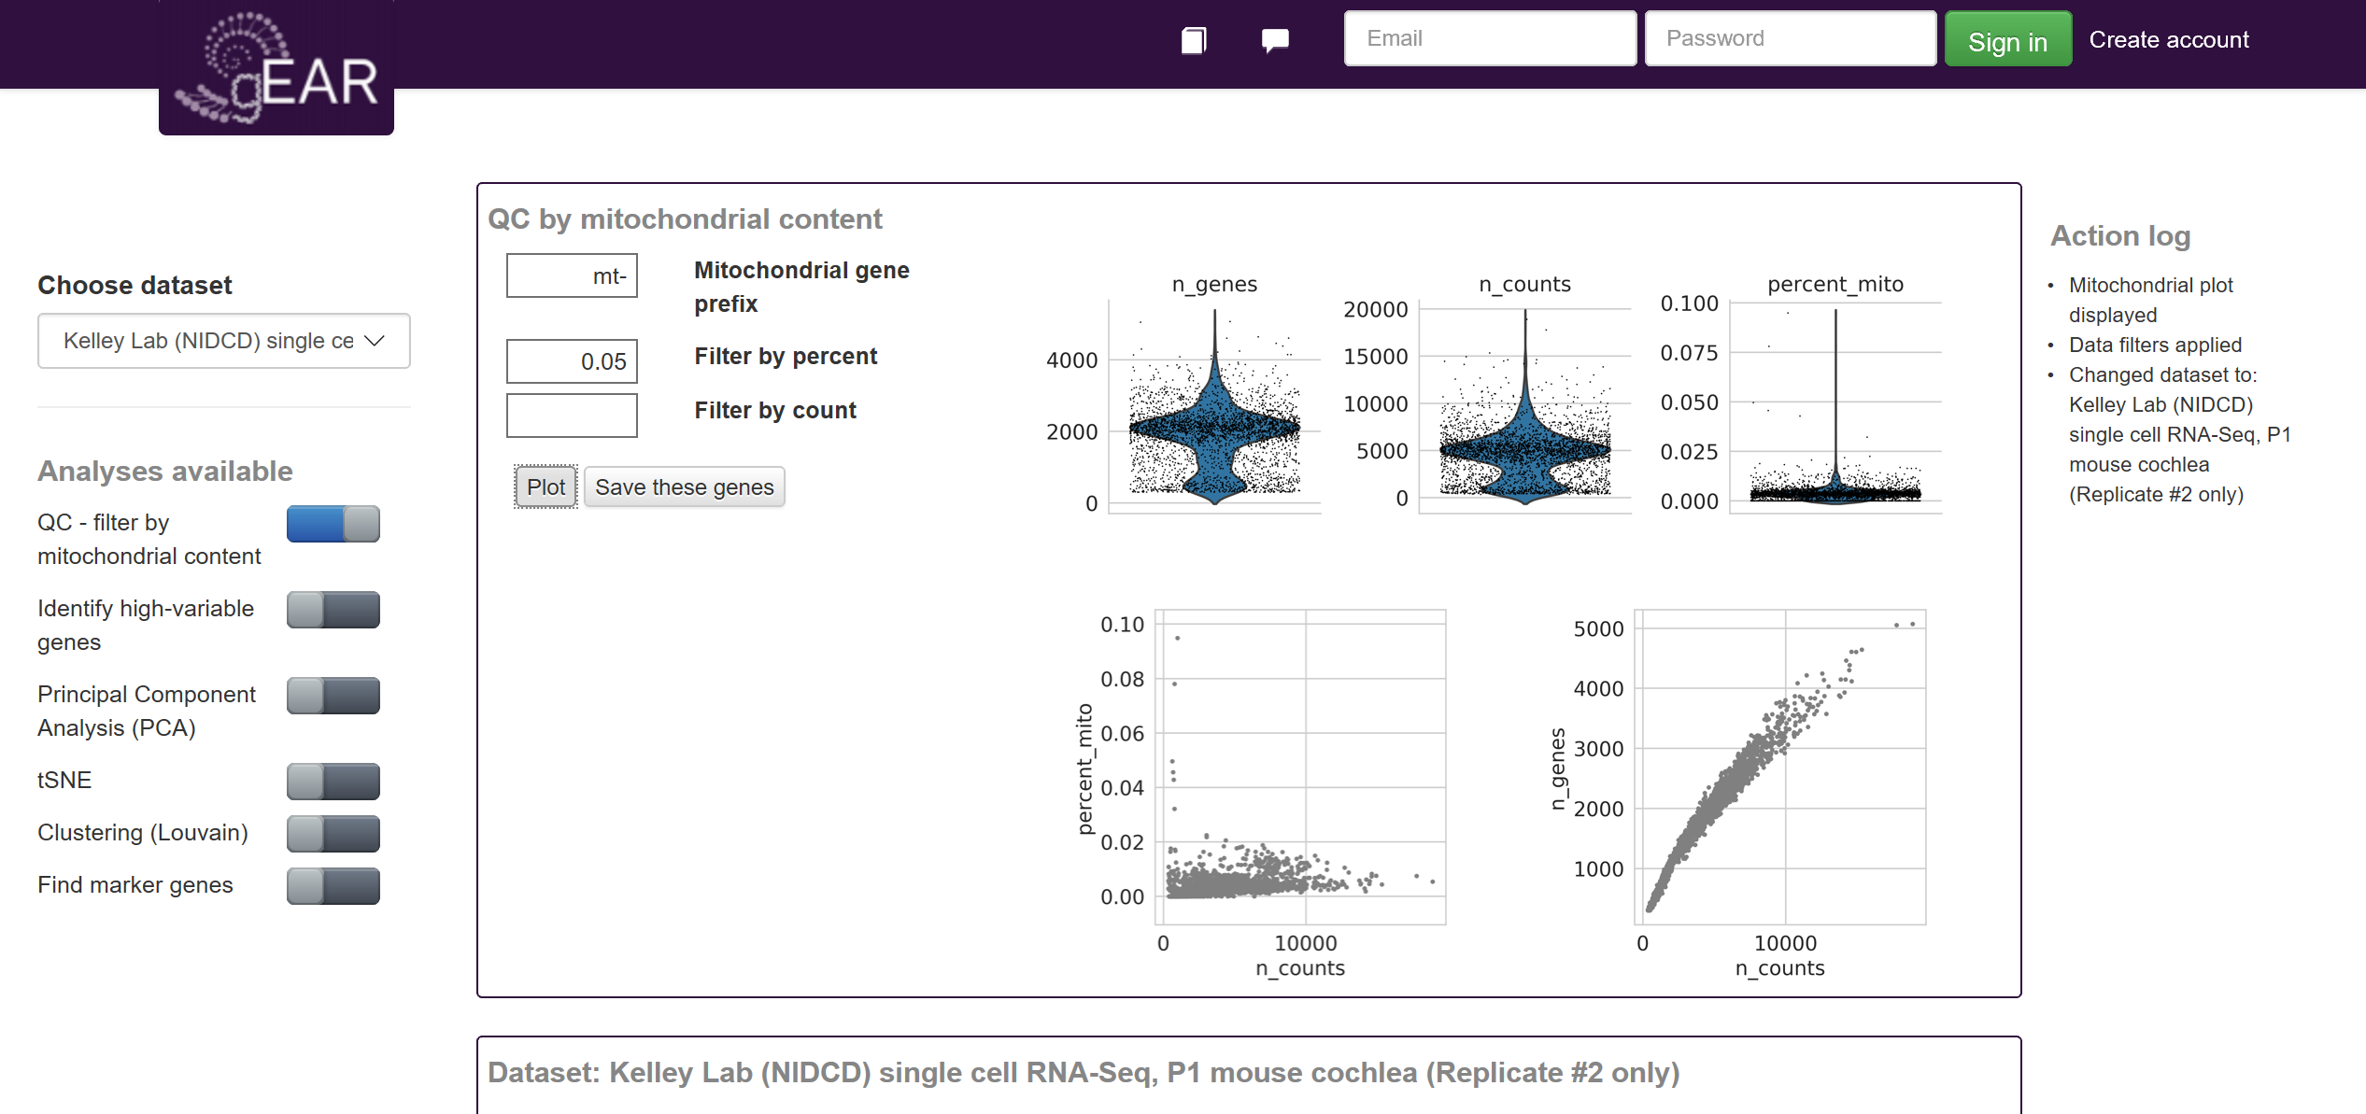


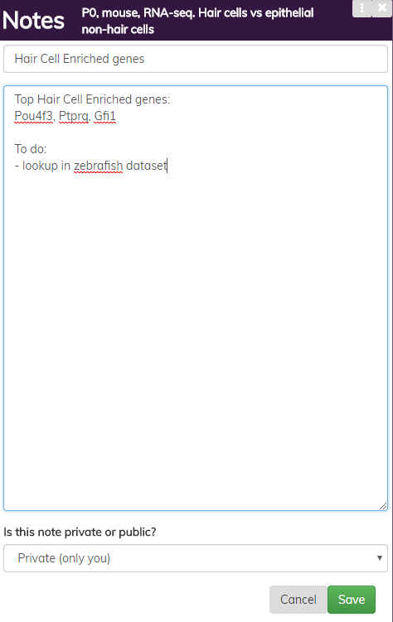
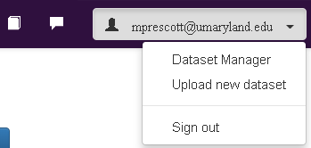
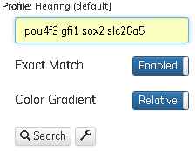
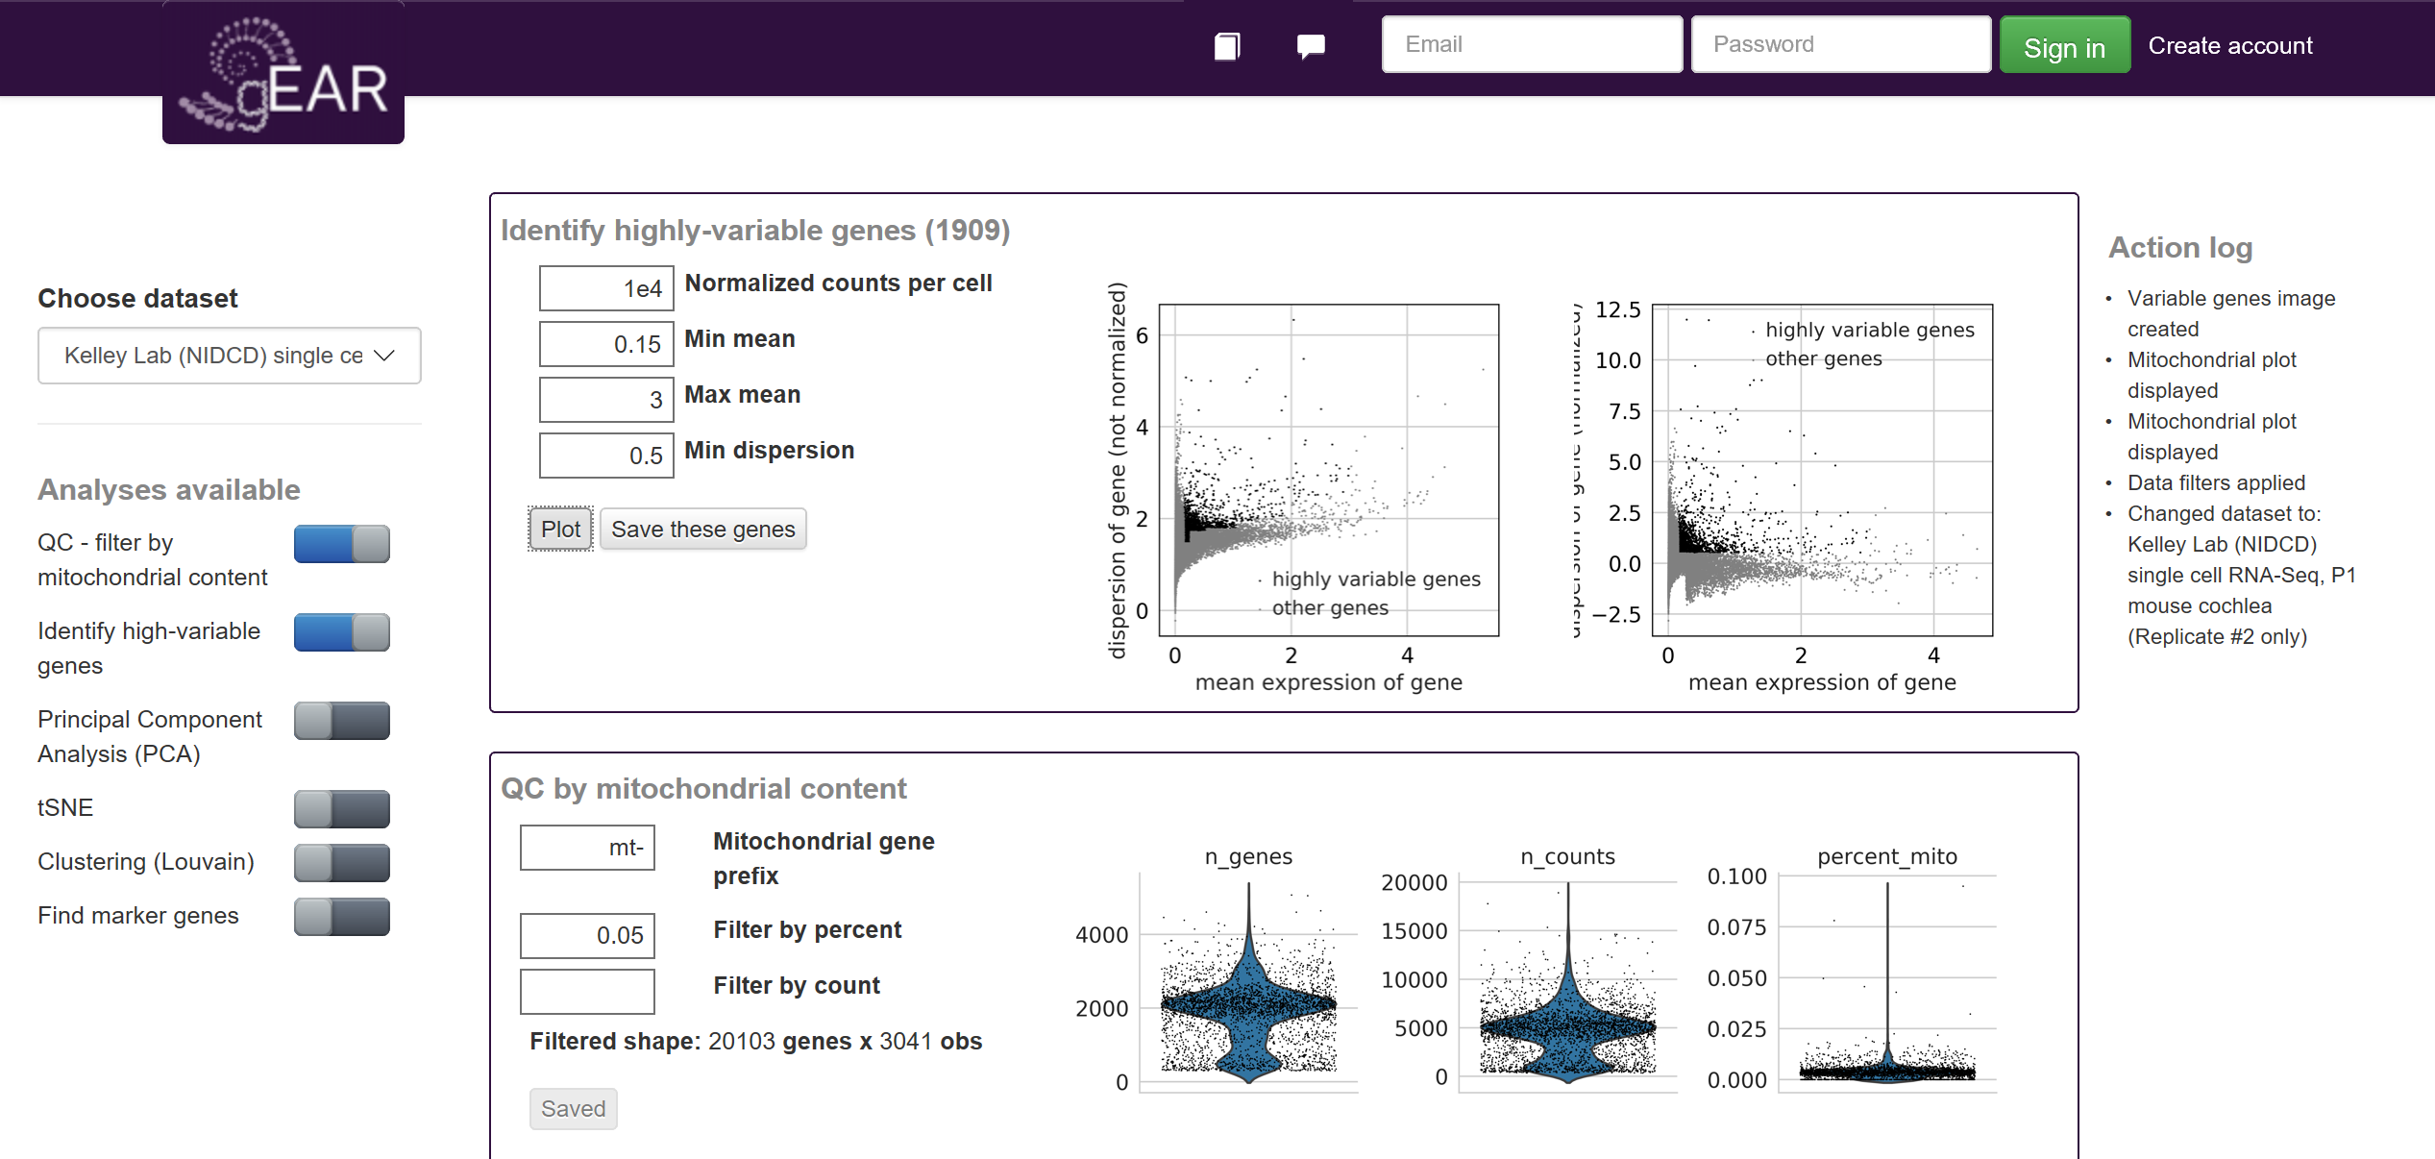
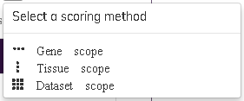
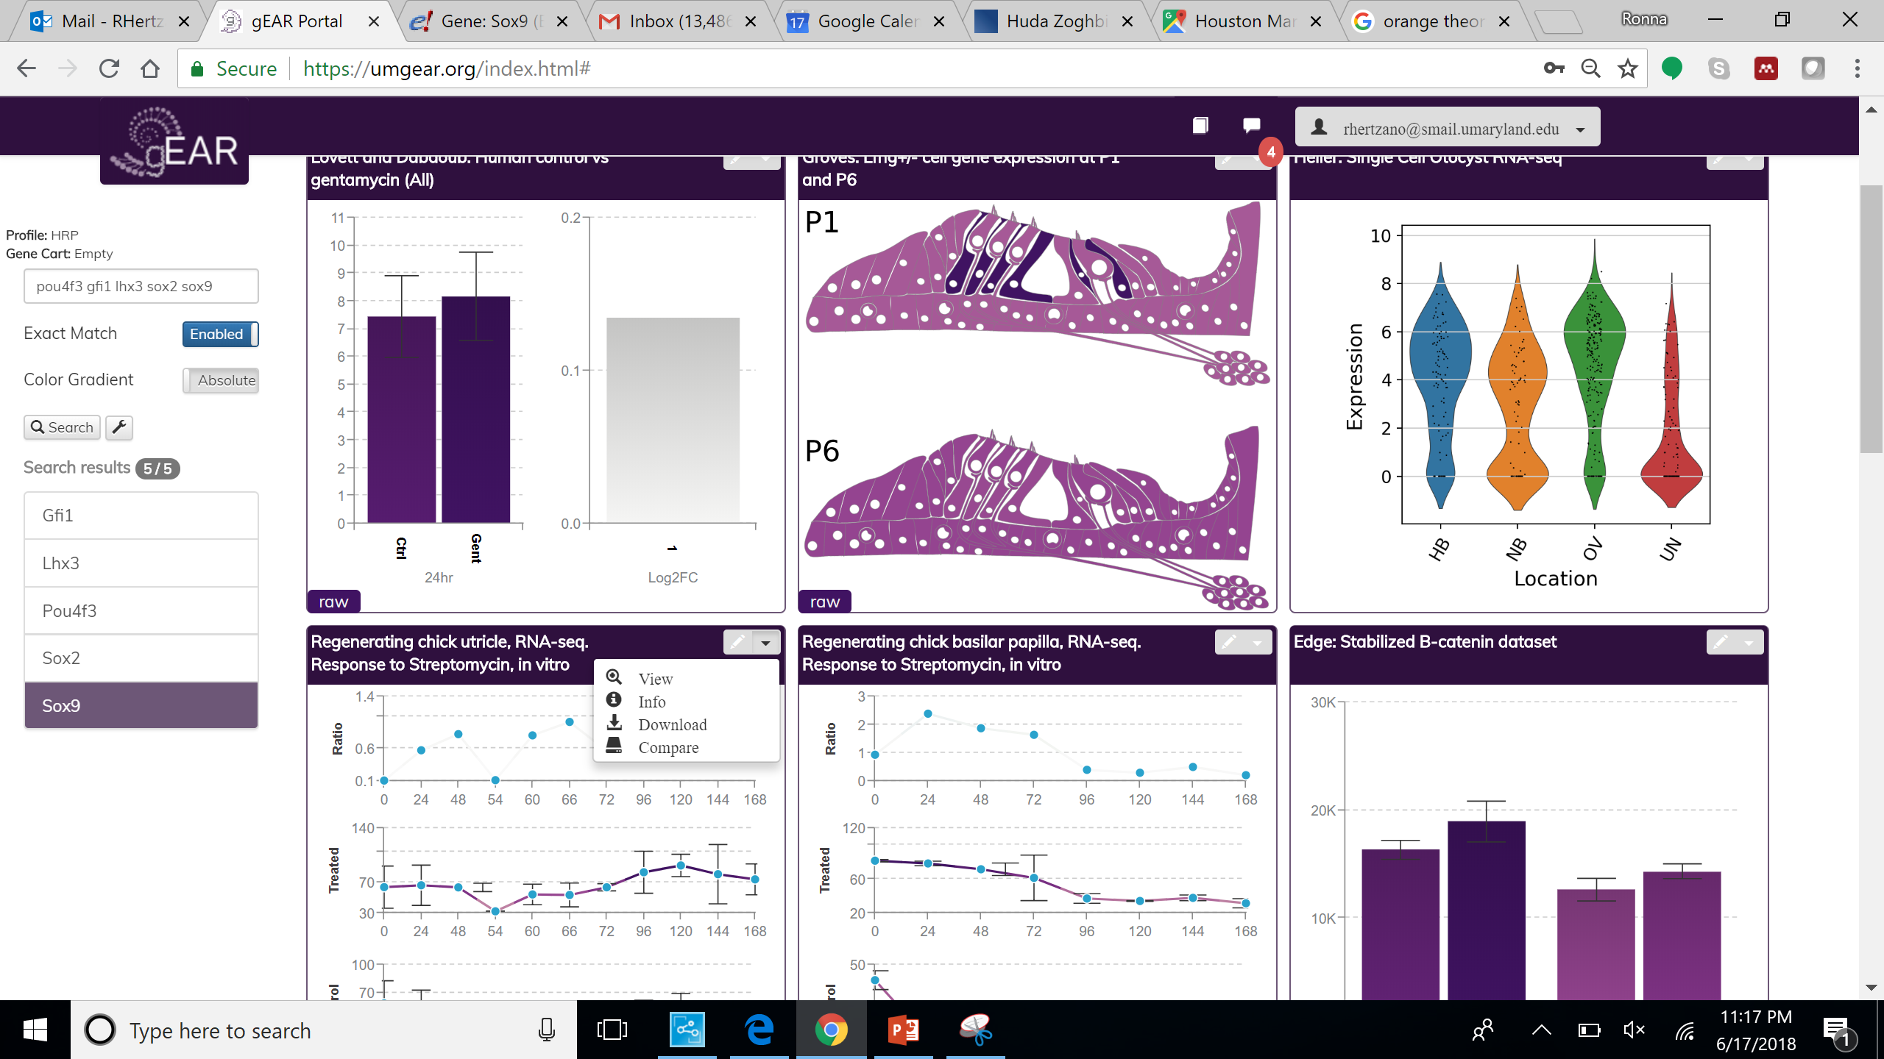
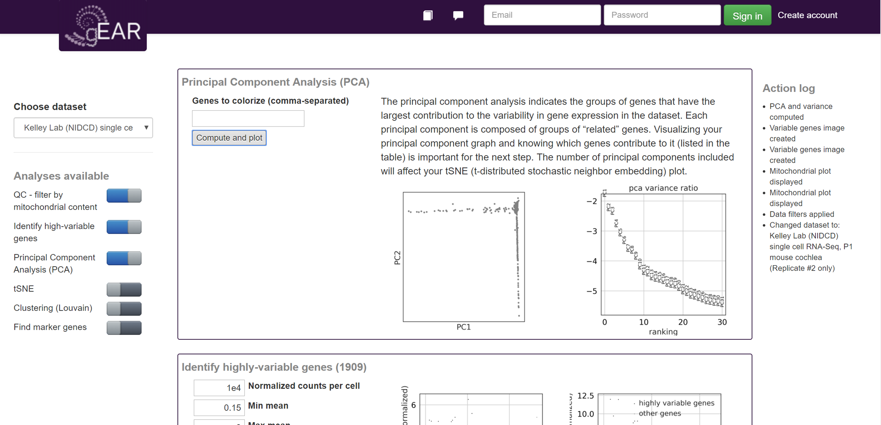
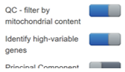
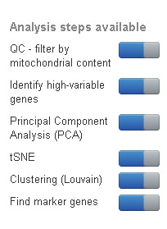
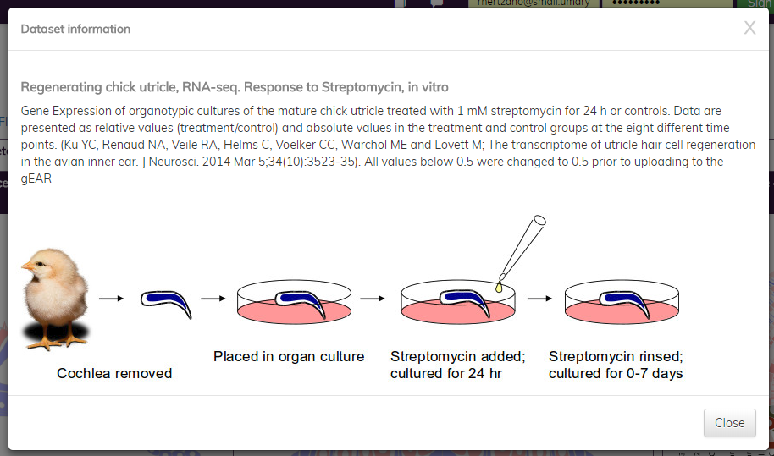
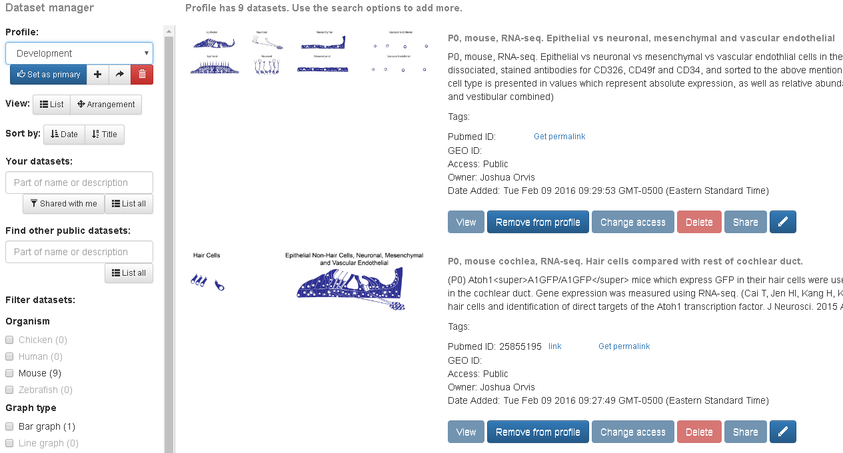
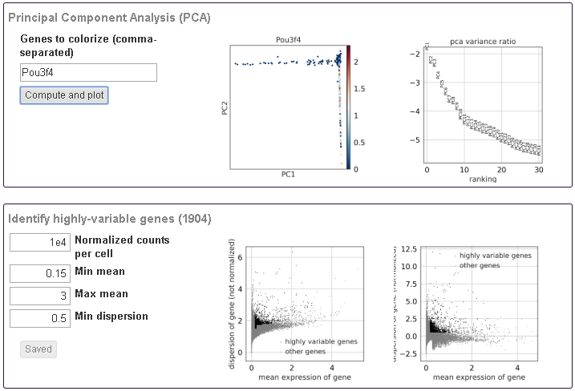
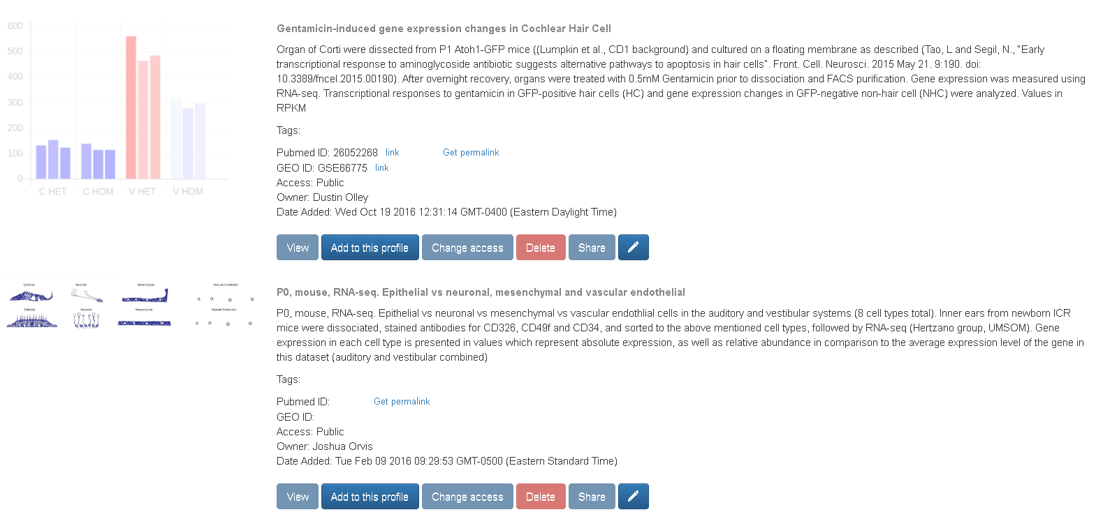
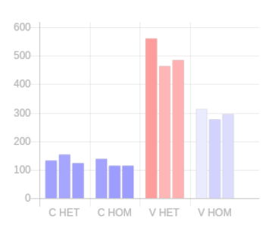
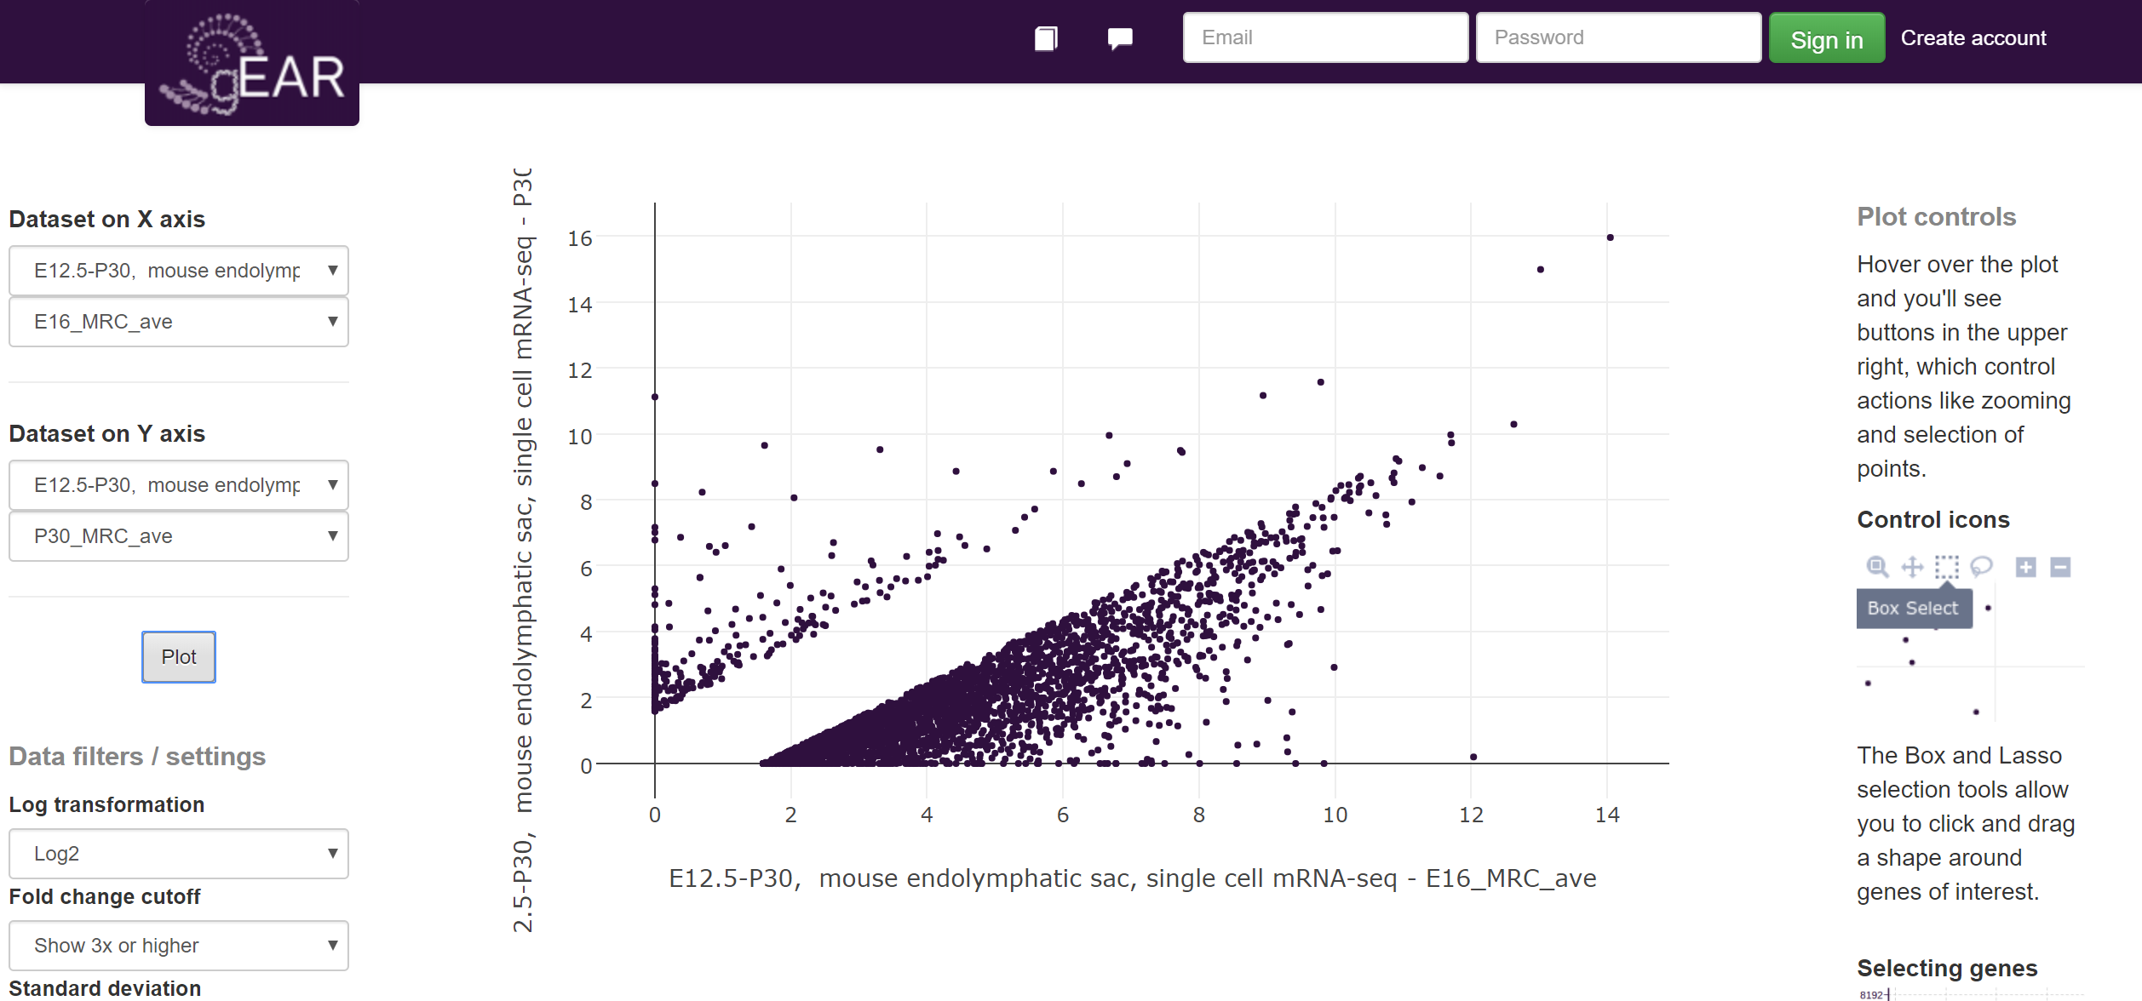
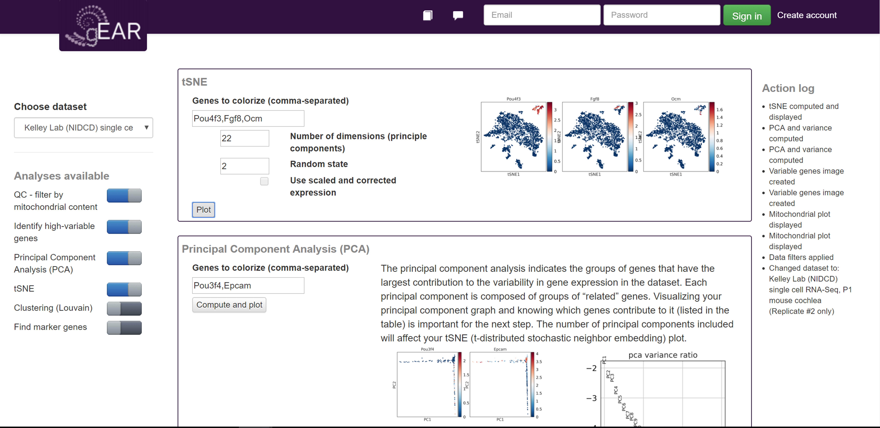
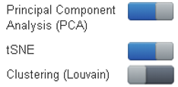
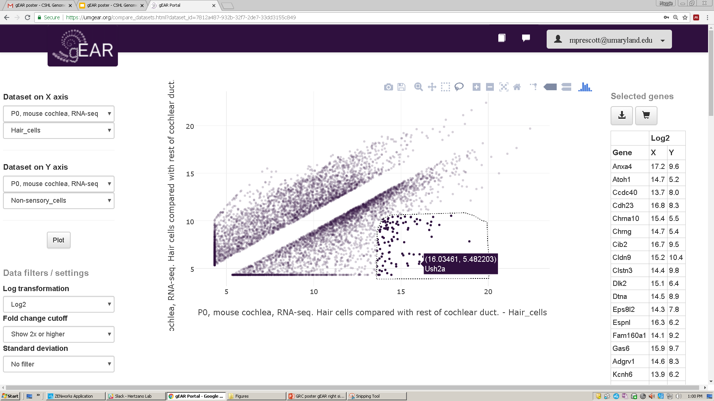

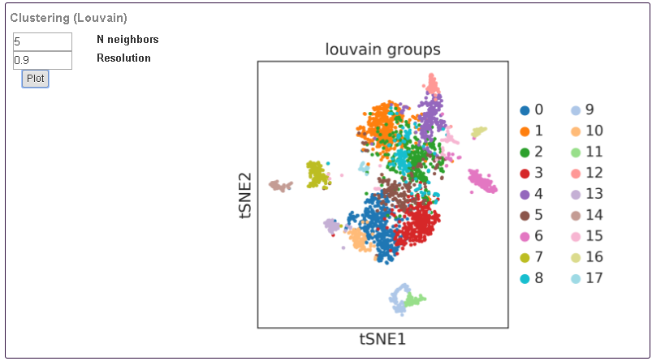
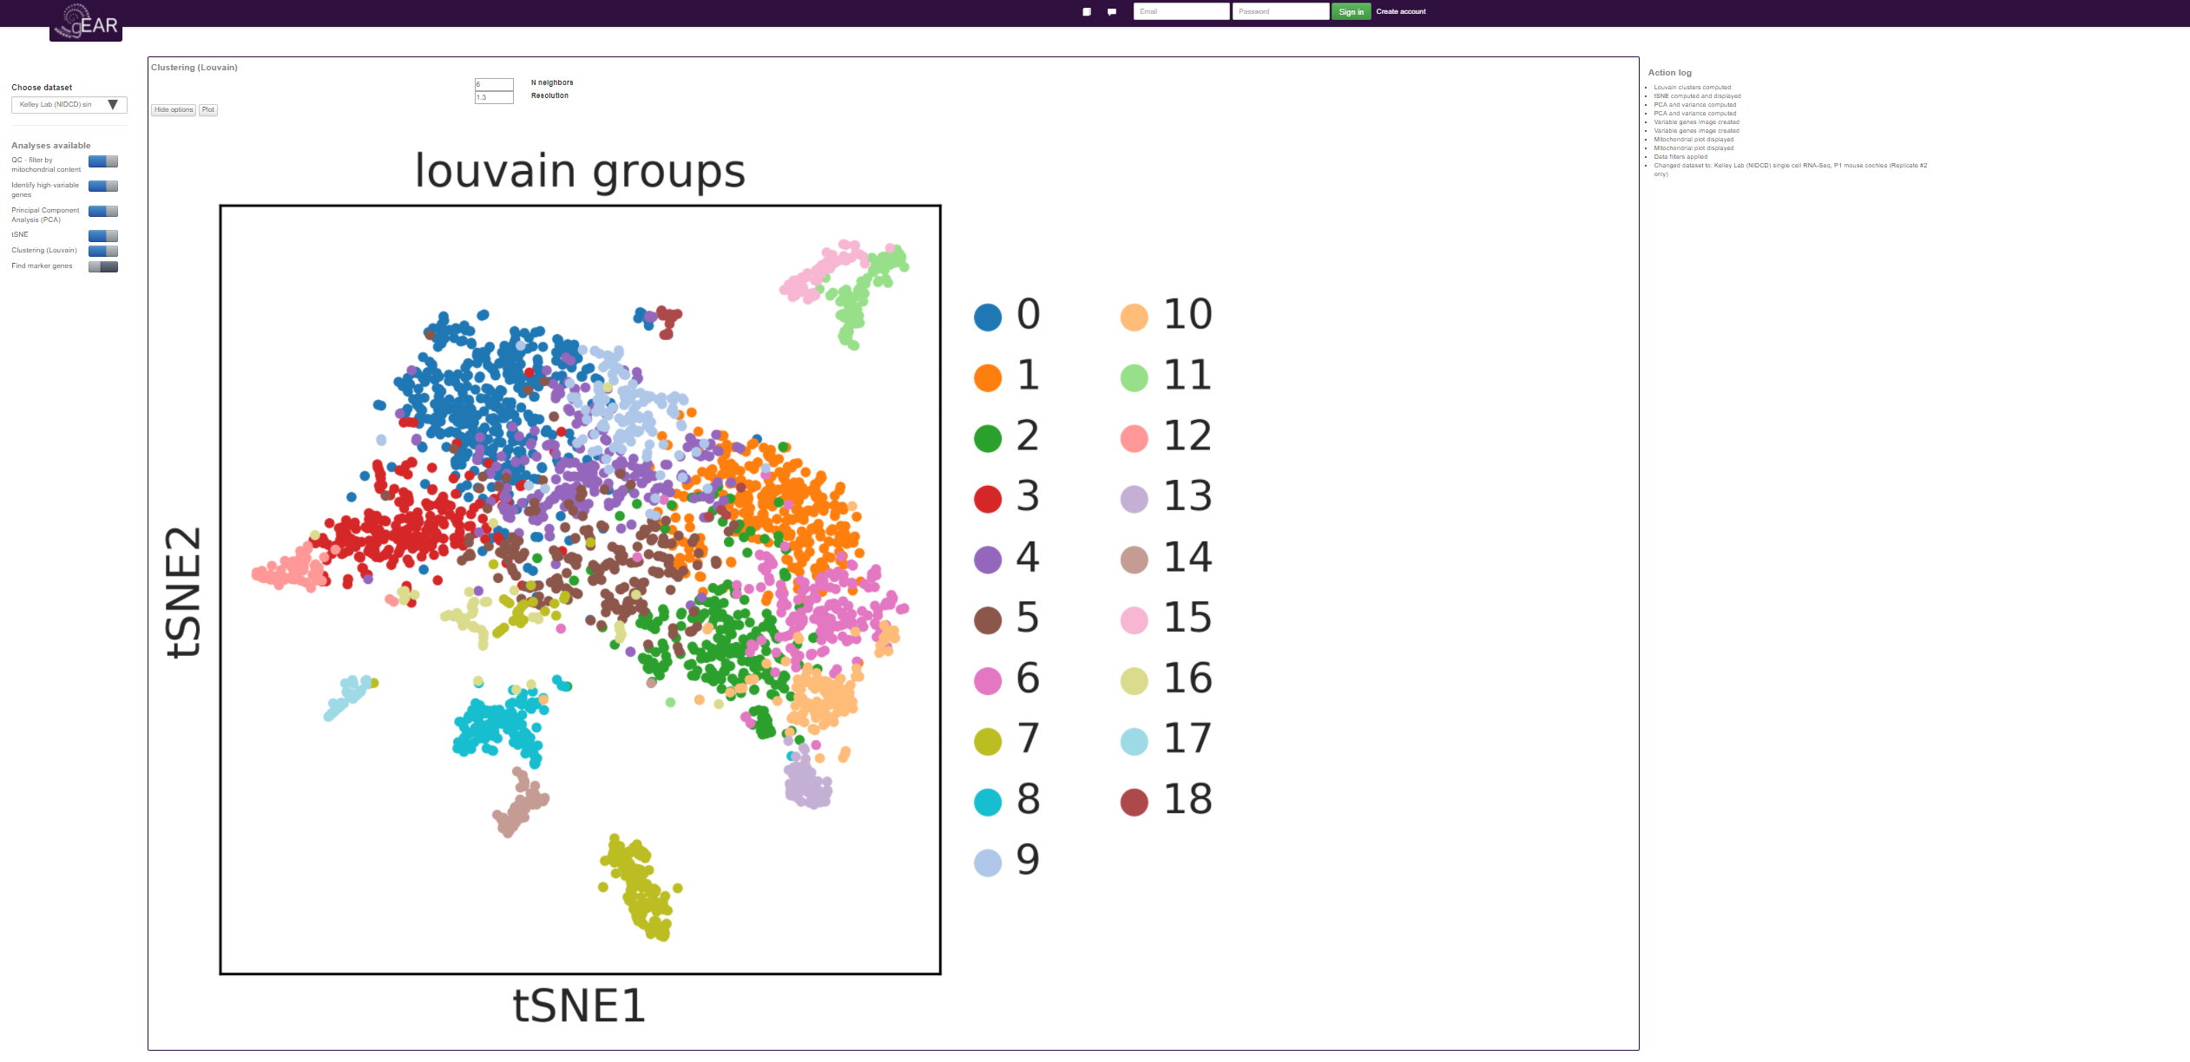
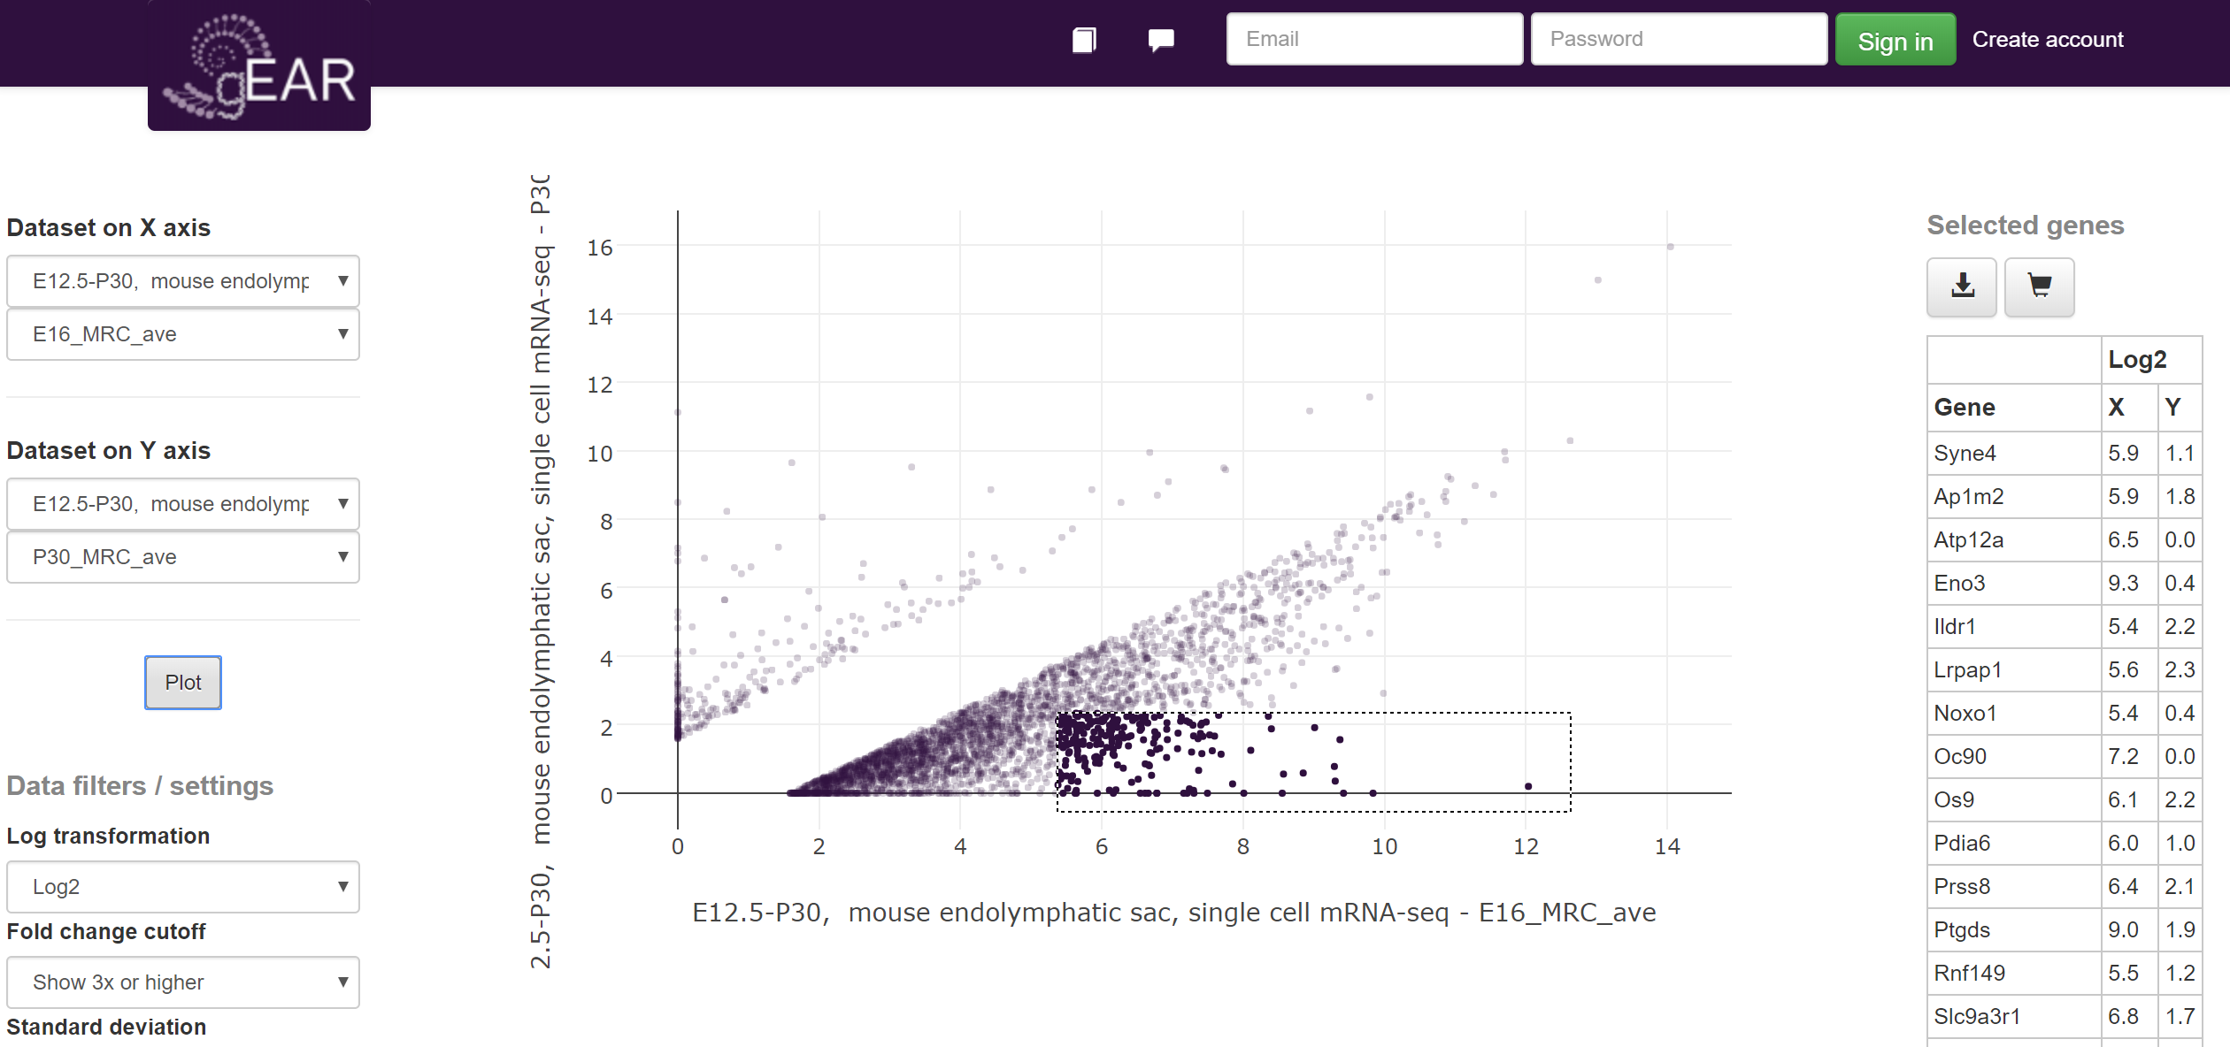
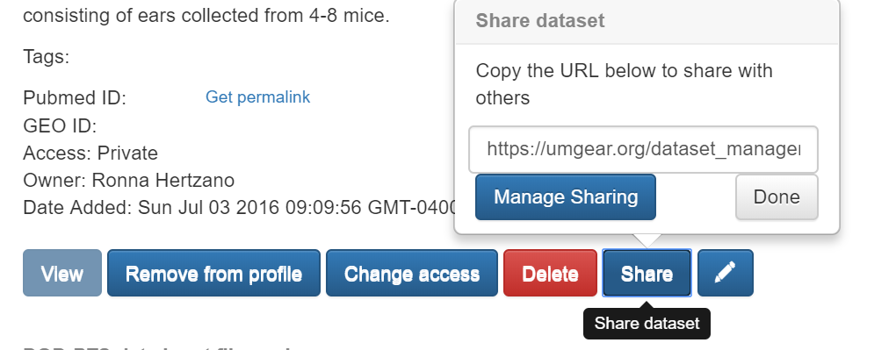
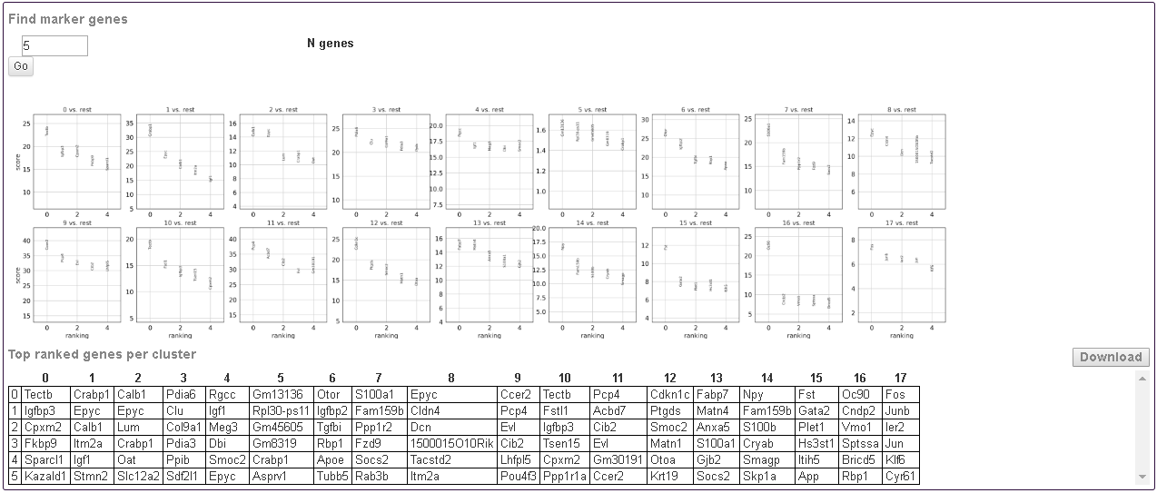
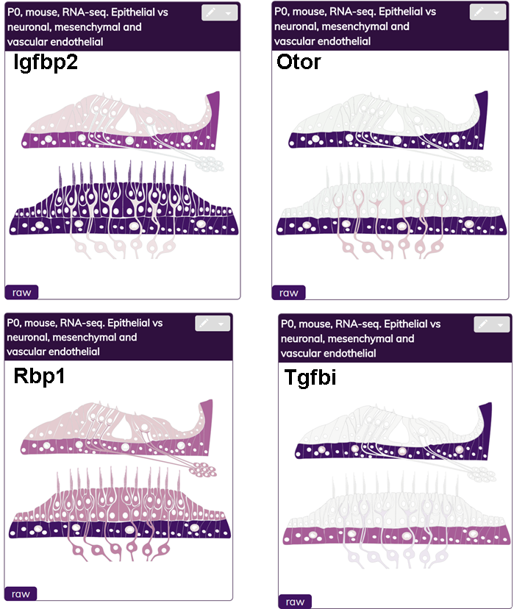
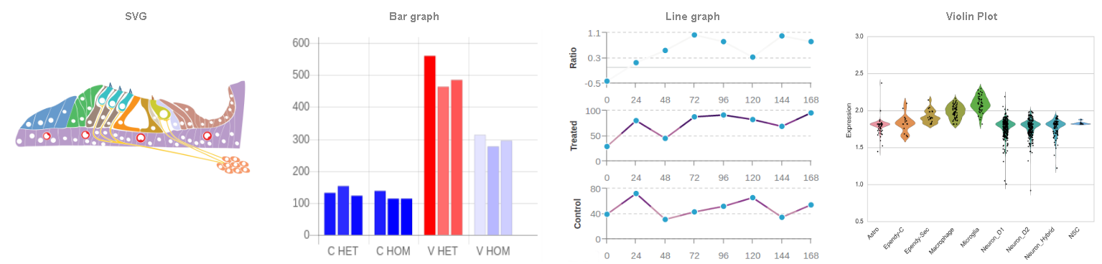
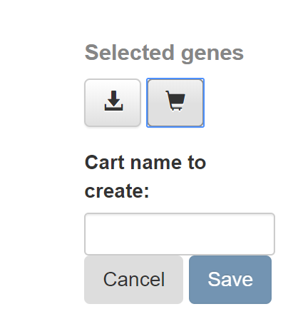


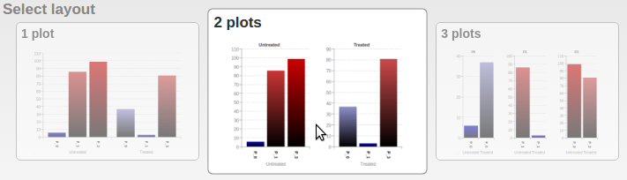
The gEAR portal v2: a one-stop shop for ear related multi-omic data visualization and analysis
Joshua Orvis¹, Dustin Olley¹, Jayaram Kancherla², Beatrice Milon¹, Yang Song¹, Hector C. Bravo², Anup A. Mahurkar¹ and Ronna Hertzano¹
Affiliations: ¹University of Maryland School of Medicine-Baltimore; ²University of Maryland-College Park
Introduction to the gEAR Portal
The Single Cell Analysis Workbench
The gEAR portal (gene Expression Analysis Resource, umgear.org) is an online tool for multi-omic and multi-species data visualization, sharing, and analysis. Specifically, the ‘Hearing’ domain of the gEAR portal is designed and maintained for auditory and vestibular researchers. The gEAR is unique in its ability to allow users to upload, view and analyze their own data in the context of previously published datasets, as well as confidentially share their data with collaborators prior to publication. It is also unique in combining not only multiple species but multiple data types including bulk RNA-seq, sorted cell RNA-seq, single cell RNA-seq (scRNA-seq) and epigenomics in a one page, user-friendly, browseable format. Most recently, scRNA-seq has matured to a commonly used technique for measuring gene expression across tissues. To provide researchers access to scRNA-seq data regardless of their programming knowledge, we have integrated a scRNA-seq workbench into the gEAR. The gEAR scRNA-seq workbench provides access to both the raw data of scRNA-seq datasets, as well as to saved expert analyses where cell types have already been assigned – giving researchers rapid insight into gene expression of their cell type of interest. This poster presentation functions as a step-by-step introduction to the gEAR portal, now a mainstream multi-omic data source for the ear research community.
The gEAR is supported by the Hearing Restoration Project (Hearing Health Foundation) and the NIDCD, NIH (R01DC013817).
The Single Cell Analysis Workbench is a tool under active development. This tool currently implements much of the Seurat pipeline in a graphical user-interface and in an implementation that allows faster data processing and visualization than standard R-based pipelines.
The analysis workbench is accessible from the dropdown menu
1.
3
4
Tool tip – hover over for info
1 - Choose a dataset
Expanded Functional Annotation Tab
After choosing the dataset (1) and obtaining the ‘dataset structure’ (2) work through the steps of the analysis using the ‘toggle buttons’
A quality control step follows (3). This filters cells based on their mitochondrial content.
To perform the downstream principal component and tSNE analysis first identify a group of highly variable genes (4). For efficiency, the workbench limits users to a maximum of 2,000 genes.
The PCA (5) outlines the number of principle components identified and allows users to examine the expression of genes in the first and second PCs. Coming soon – Heat Maps for the genes contributing to each PC.
Generate a tSNE plot (6) by selecting the number of PCs to incorporate. You may check expression of genes of interest by typing their symbols in the search box.
Following the Louvain clustering (7) marker genes can be identified (8) and downloaded as a table to then use as input to search other datasets for validation. For example – population ‘6’ (top gene Otor) is clearly mesenchymal cells.
2 – Filter by gene number
2
5
Note-Taking Feature
3 – QC mito
Link-Outs to Other Databases
3.
1
Gene Search
A single gene or a list of genes can be used as a search object.
Several options for relative or absolute coloring of values are also available.
username@UMgEAR.org
6
4 – Variable Genes
Drop-Down Menu
4.
username@UMgEAR.org
Dataset Manager
The drop-down menu offers additional features and tools which may vary between datasets
7
Dataset Description
5 – PCA
10a
If a user chooses to register with the gEAR, they can also access the dataset manager
Pou3f4
8a
5.
Interactive Compare Tool
Comparison of any two conditions within the selected dataset via an X-Y scatter plot
6 – tSNE
10b
Create Your Own Profile
6.
Users can generate their own ‘profiles’ by choosing groups of datasets to be viewed together. Currently, the gEAR has over 30 public datasets that users can choose from to build personal profiles.
8b
Hover-over ability to get information on each data point.
7 – Louvain
10c
Sharing Data
Datasets and profiles can be privately shared with colleagues or posted publically.
7.
8 – Find Markers
Find marker genes
username@UMgEAR.org
Data Uploader
Step 3: Upload Expression Data
8c
9
Users can upload their data following a step-by-step process
The format the data file depends on the display chosen in step 1
Ability to select genes of interest by drawing a shape around them. The list appears as a table on the right side.
Step 1: Select display type
Step 3 also let the user to organize their data, for example:
Renaming headers
8d
Download the selected gene list as a plain text file , or save it as a ‘gene cart’ within the system where it can be used via the main page of the gEAR as a search input.
Step 2: Describe Data
Changing the order of columns
8.
Title, description of sample, decide Private or Public
Representing bar graphs as 1 plot, 2 plots or 3 plots

